Slide 1
Java Architecture
Name: Akash Hedau
Batch: 10224

Slide 2
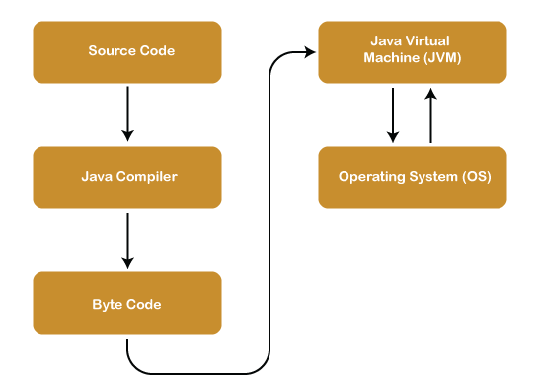
Java Architecture:
It is structural design and organization of the various components that make up the Java programming language
Its follow the WORA (Write once ,Run anywhere) principal.

Slide 3
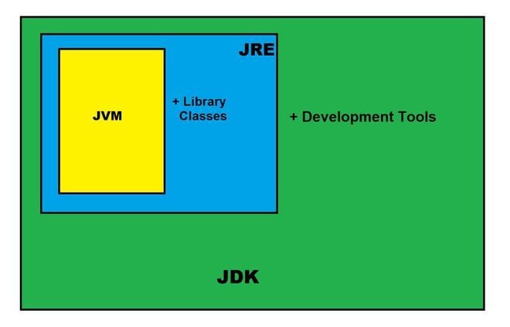
JDK(Java Development kit)
It is used to build Java applications.
JDK contains a compiler, the Java Runtime Environment (JRE) and a library
JDK 1.0 was released on January 23, 1996. After the first release of Java, there have been many additional features added to the language each new version adds new features in Java

Slide 4
JVM(Java Virtual Machine)
JVM(Java Virtual Machine) acts as a run-time engine to run Java applications
There are Three parts of JVM
Class Loader: Used to load class file in main memory.
JVM: It is responsible for executing the java program line by line, hence it is also known as an interpreter
Interpreter
Execute the Byte Code
Make appropriate calls to the underlying hardware
JIT(Just in Time Compiler) : It helps in improving the performance
Garbage Collector: It is process of deleting code that's no longer needed or used

Slide 5
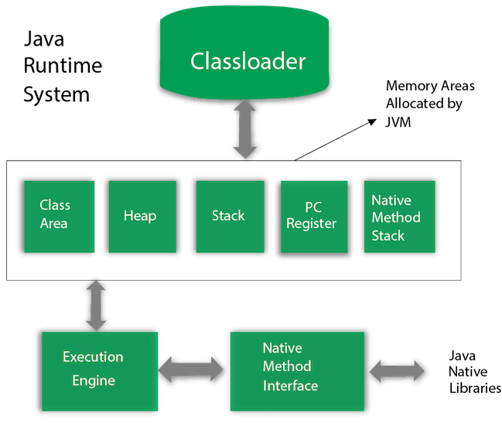
JVM( Java Virtual Machine)

Slide 6
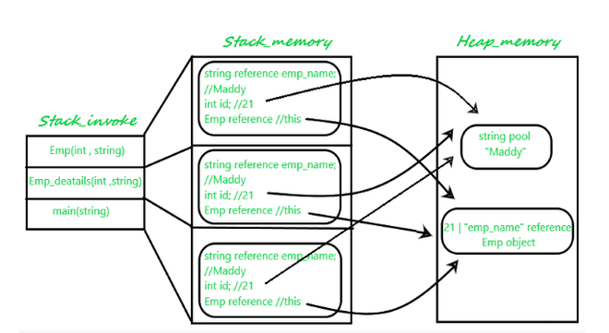

Slide 7
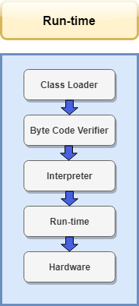
JRE(Java Runtime Environment)
It is a software package that provides the necessary runtime components
JRE includes the Java Virtual Machine (JVM), class libraries, and other resources needed to run Java programs.

